Slide 1
MGB235 MONITORING AND MANAGING OPERATIONAL PERFORMANCE
Week 11: Sales and Operational Planning &
Resources Planning
Chapters 11 & 13:
Stevenson, W.J. (2021) 14th ed. Operations Management, McGraw Hill, New York, NY.
Chapters 14 & 15
Russell, Roberta S., and Taylor III, Bernard W. (2017) Operations management: Creating value along the supply chain, 9th ed., Hoboken: NJ.

Slide 2
Lecture Outline
Sales and Operational Planning
The Sales and Operations Planning Process
Strategies for Adjusting Capacity
Strategies for Managing Demand
Quantitative Techniques for Aggregate Planning
Hierarchical Nature of Planning
Aggregate Planning for Services
Resource Planning
Material Requirements Planning (MRP)
Capacity Requirements Planning (CRP)
Enterprise Resource Planning (ERP)
Customer Relationship Management (CRM)
Supply Chain Management (SCM)

Slide 3
Sales and Operations Planning
Determines resource capacity to meet demand over an intermediate time horizon
Aggregate refers to sales and operations planning for product lines or families
Sales and Operations planning (S&OP) matches supply and demand
Sales & Operational Planning Objectives
Establish a company wide plan for allocating resources
Develop an economic strategy for meeting demand

Slide 4
Why Use Aggregate Planning
Why do organizations need to do aggregate planning?
Planning
It takes time to implement plans
Strategic
Aggregation is important because it is not possible to predict with accuracy the timing and volume of demand for individual items
It is connected to the budgeting process
It can help synchronize flow throughout the supply chain; it affects costs, equipment utilization, employment levels, and customer satisfaction
11-4

Slide 5
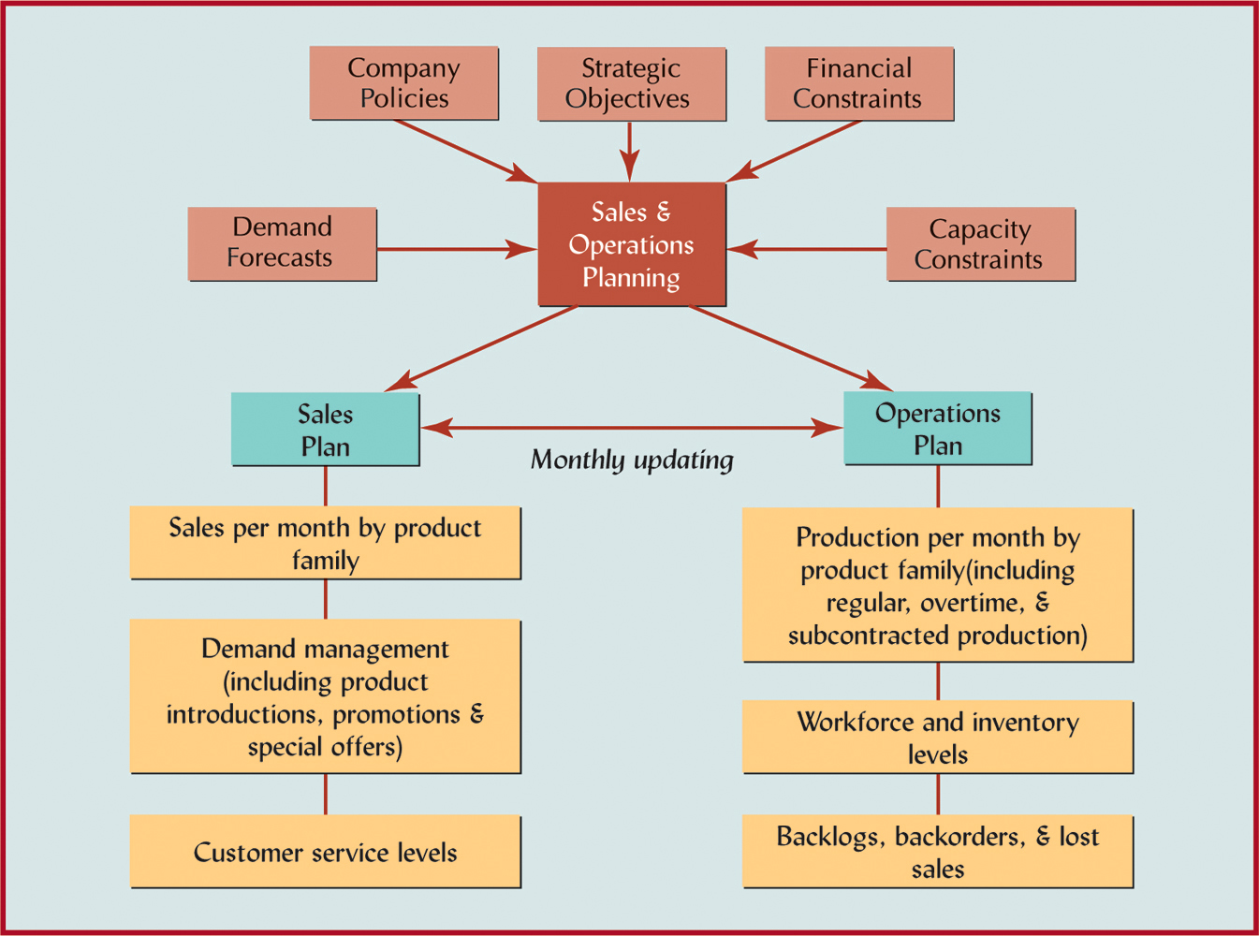
Sales and Operations Planning Process

Slide 6
Overview of Aggregate Planning
Forecast of aggregate demand for the intermediate range
Develop a general plan to meet demand requirements
Update the aggregate plan periodically (e.g., monthly)
Copyright ©2021 McGraw-Hill Education. All rights reserved. No reproduction or distribution without the prior written consent of McGraw-Hill Education.
11-6

Slide 7
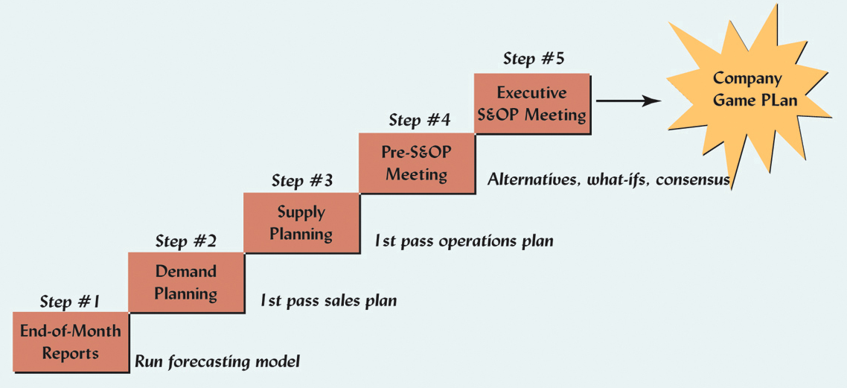
Monthly S&OP Planning Process

Slide 8
What is Demand
Demand
Units
Time

Slide 9
Meeting Demand Strategies
Adjusting capacity
Resources to meet demand are acquired and maintained over the time horizon of the plan
Minor variations in demand are handled with overtime or under-time
Managing demand
Proactive demand management

Slide 10
Strategies for Managing Demand Proactive demand management
Partnering with suppliers to reduce information distortion along the supply chain
Offering products or services with counter-cyclical demand patterns
Shifting demand into other time periods
Incentives
Sales promotions
Advertising campaigns

Slide 11
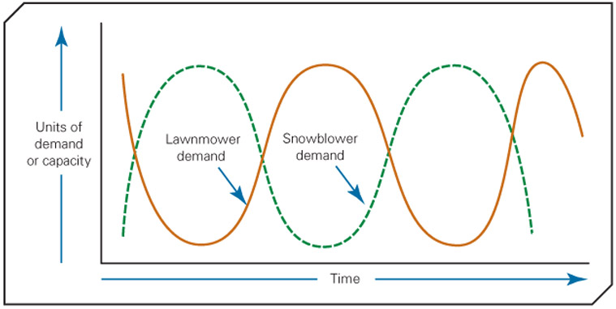
Offering products or services with counter-cyclical demand patterns
e.g. Seasonal Demand and Complementary Products
Notes:
Reverse cycle air conditioners

Slide 12
Strategies for Adjusting Capacity
Level production
1.Producing at a constant rate and using inventory to absorb fluctuations in demand
Chase demand
2. Hiring and firing workers to match demand
Peak demand
3. Maintaining resources (staffing) for high levels of customer service

Slide 13
Strategies for Adjusting Capacity
Overtime and under-time
4. Increase or decrease working hours
Subcontracting
5. Let outside companies complete the work (outsource)
Part-time workers
6. Hire part-time workers to complete the work
Backordering
7. Provide the service or product at a later time period

Slide 14
Summary: Strategies for Matching Supply and Demand for Services
DEMAND
STRATEGIES
SUPPLY
STRATEGIES
Partitioning
demand
Increasing
customer
participation
Developing
complementary
services
Sharing
capacity
Establishing
price
incentives
Scheduling
work shifts
Developing
reservation
systems
Cross-
training
employees
Promoting
off-peak
demand
Creating
adjustable
capacity
Using
part-time
employees
Yield
management

Slide 15
Level Production
Demand
Units
Production
Time

Slide 16
Chase Demand
Demand
Production
Units
Time

Slide 17
Pure Strategies
QUARTER SALES FORECAST (LB)
Spring 80,000
Summer 50,000
Fall 120,000
Winter 150,000
Hiring cost = $100 per worker
Firing cost = $500 per worker
Inventory carrying cost = $0.50 pound per quarter
Regular production cost per pound = $2.00
Production per employee = 1,000 pounds per quarter
Beginning work force = 100 workers

Slide 18
Level Production Strategy
Level production
(80,000 + 50,000 + 120,000 + 150,000)
4
= 100,000 pounds
SALES PRODUCTION
QUARTER FORECAST PLAN INVENTORY
Spring 80,000 100,000 20,000
Summer 50,000 100,000 70,000
Fall 120,000 100,000 50,000
Winter 150,000 100,000 0
400,000 140,000
Cost of Level Production Strategy
(400,000 X $2.00) + (140,00 X $.50) = $870,000

Slide 19
Chase Demand Strategy
SALES PRODUCTION WORKERS WORKERS WORKERS
QUARTER FORECAST PLAN NEEDED HIRED FIRED
Spring 80,000 80,000 80 0 20
Summer 50,000 50,000 50 0 30
Fall 120,000 120,000 120 70 0
Winter 150,000 150,000 150 30 0
100 50
Cost of Chase Demand Strategy
(400,000 X $2.00) + (100 x $100) + (50 x $500) = $835,000

Slide 20
Other Production Strategies: Mixed Strategy
Combination of Level Production and Chase Demand strategies
Example policies
no more than x% of workforce can be laid off in one quarter
inventory levels cannot exceed x dollars
Some industries may shut down manufacturing during the low demand season and schedule employee vacations during that time

Slide 21
Collaborative Planning
Sharing information and synchronizing production across supply chain
Part of CPFR (collaborative planning, forecasting, and replenishment)
involves selecting products to be jointly managed, creating a single forecast of customer demand, and synchronizing production across supply chain

Slide 22
Disaggregation
Breaking an Aggregate Plan into more detailed plans
Create Master Production Schedule for Material Requirements Planning

Slide 23
Disaggregation
Aggregate
Plan
Disaggregation
Master
Schedule
Copyright ©2021 McGraw-Hill Education. All rights reserved. No reproduction or distribution without the prior written consent of McGraw-Hill Education.
11-23

Slide 24
Hierarchical Nature of Planning
Production Planning
Capacity Planning
Resource Level
Items
Product lines or families
Sales and Operations Plan
Resource requirements plan
Plants
Individual products
Master production schedule
Rough-cut capacity plan
Critical work centers
Material requirements plan
Capacity requirements plan
All work centers
Components
Manufacturing operations
Shop floor schedule
Input/ output control
Individual machines

Slide 25
Aggregate Planning for Services
Most services cannot be inventoried
Demand for services is difficult to predict
Capacity is also difficult to predict
Service capacity must be provided at the appropriate place and time
Labor is usually the most constraining resource for services

Slide 26
Aggregate Planning in Services
Hospitals:
Aggregate planning used to allocate funds, staff, and supplies to meet the demands of patients for their medical services
Airlines:
Aggregate planning in this environment is complex due to the number of factors involved
Capacity decisions must take into account the percentage of seats to be allocated to various fare classes in order to maximize profit or yield
Restaurants:
Aggregate planning in high-volume businesses is directed toward smoothing the service rate, determining workforce size, and managing demand to match a fixed capacity
Can use inventory; however, it is perishable
Copyright ©2021 McGraw-Hill Education. All rights reserved. No reproduction or distribution without the prior written consent of McGraw-Hill Education.
11-26

Slide 27
Yield Management
Yield management
An approach to maximizing revenue by using a strategy of variable pricing; prices are set relative to capacity availability
During periods of low demand, price discounts are offered
During periods of peak demand, higher prices are charged
Users of yield management include
Airlines, restaurants, hotels, restaurants
Copyright ©2021 McGraw-Hill Education. All rights reserved. No reproduction or distribution without the prior written consent of McGraw-Hill Education.
11-27

Slide 28
Resource Planning: Lecture Outline
Material Requirements Planning (MRP)
Capacity Requirements Planning (CRP)
Enterprise Resource Planning (ERP)
Customer Relationship Management (CRM)
Supply Chain Management (SCM)

Slide 29
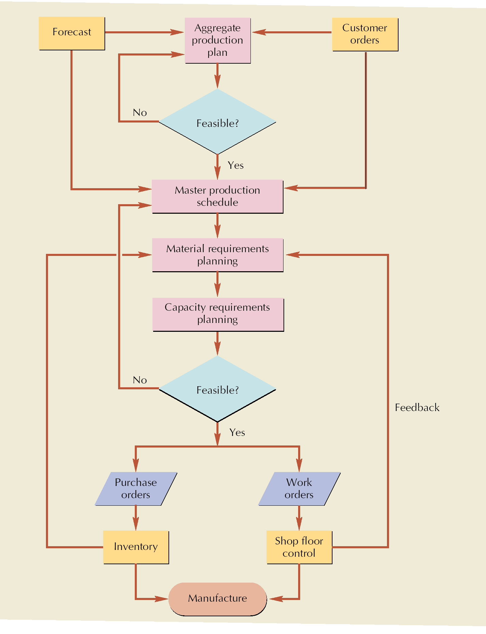
Resource Planning for Manufacturing starts with the Aggregate Plan

Slide 30
Material Requirements Planning (MRP)
Computerized inventory control and production planning system
When to use MRP?
Dependent demand items
Discrete demand items
Complex products
Job shop production
Assemble-to-order environments

Slide 31

Demand Characteristics
Independent demand
Dependent demand
100 x 1 =
100 tabletops
100 tables
100 x 4 = 400 table legs
400 –
300 –
200 –
100 –
Continuous demand
400 –
300 –
200 –
100 –
Discrete demand
No. of tables
No. of tables
1 2 3 4 5
Week
M T W Th F M T W Th F

Slide 32
Material Requirements Planning
Master production schedule
Product
structure
file
Material
requirements
planning
Item
master
file
Planned order releases
Work orders
Purchase orders
Rescheduling notices

Slide 33
MRP Inputs and Outputs
Inputs
Master production schedule
Product structure file
Item master file
Outputs
Planned order releases
Work orders
Purchase orders
Rescheduling notices

Slide 34
Calculating Capacity
Maximum capability to produce
Rated Capacity (theoretical capacity)
Theoretical output that could be attained if a process were operating at full speed without interruption, exceptions, or downtime
Effective Capacity
Takes into account the efficiency with which a particular product or customer can be processed and the utilization of the scheduled hours or work
Effective Daily Capacity = (no. of machines or workers) x (hours per shift) x (no. of shifts) x (utilization) x ( efficiency)

Slide 35
Calculating Capacity
Utilization
Percent of available time spent working
Efficiency
How well a machine or worker performs compared to a standard output level
Load
Standard hours of work assigned to a facility
Load Percent
Ratio of load to capacity
load
capacity
Load Percent = x 100%

Slide 36
Example: Copy Courier
Two high-speed copiers that can be operated by one operator.
2 shifts per day
8 hours/shift , 5 days/week.
No breaks during the day
30 minutes for lunch or dinner
Machine service time = 30 minutes at the beginning of each shift
Machine efficiency = 90%.
Capacity
2 copiers * 2 shifts * 8 hrs/shift * 7/8 utilization * .90 efficiency = 1512 minutes/day

Slide 37
Copy Courier
Job No. of Setup Time Run Time
Copies (min) (min/unit)
10 500 5.2 0.08
20 1000 10.6 0.10
30 5000 3.4 0.12
40 4500 11.2 0.14
50 2000 15.3 0.10

Slide 38
Load Calculations
Job Setup + Run x No. Copies Job Time
10 5.2 + (500 X 0.08) = 45.20
20 10.6 + (1000 X 0.10) = 110.60
30 3.4 + (5000 X 0.12) = 603.40
40 11.2 + (4500 X 0.14) = 641.20
50 15.3 + (2000 X 0.10) = 215.30
1,615.70 min

Slide 39
Loading
Capacity
2 copiers * 2 shifts * 8 hrs/shift * 7/8 utilization * .90 efficiency = 1512 minutes/day
Load percent = 1615.70/1512 = 1.068 X 100% = 106.8%
Overloaded by 6.8%.
Solution Alternative: Extends working day by approximately 36 minutes
Load percent = 99%.
Increase efficiency to 97%.

Slide 40
Reducing Over-load Conditions
Eliminate unnecessary requirements
Reroute jobs to alternative machines, workers, or work centers
Split lots between two or more machines
Increase normal capacity
Subcontract
Increase efficiency of the operation
Push work back to later time periods
Revise master schedule

Slide 41
Load Profiles
Graphical comparison of load versus capacity
Leveling underloaded conditions:
Acquire more work
Pull work ahead that is scheduled for later time periods
Reduce normal capacity
Load leveling
Process of balancing underloads and overloads

Slide 42
Initial Load Profile
120 –
110 –
100 –
90 –
80 –
70 –
60 –
50 –
40 –
30 –
20 –
10 –
0 –
Hours of capacity
Normal
capacity
1 2 3 4 5 6
Time (weeks)

Slide 43
Adjusted Load Profile
120 –
110 –
100 –
90 –
80 –
70 –
60 –
50 –
40 –
30 –
20 –
10 –
0 –
Hours of capacity
Work an extra shift
Pull ahead
Push back
Overtime
Push back
Normal
capacity
1 2 3 4 5 6
Time (weeks)

Slide 44
Enterprise Resource Planning (ERP)
Software that organizes and manages a company’s business processes by
sharing information across functional areas
integrating business processes
facilitating customer interaction
providing benefit to global companies

Slide 45
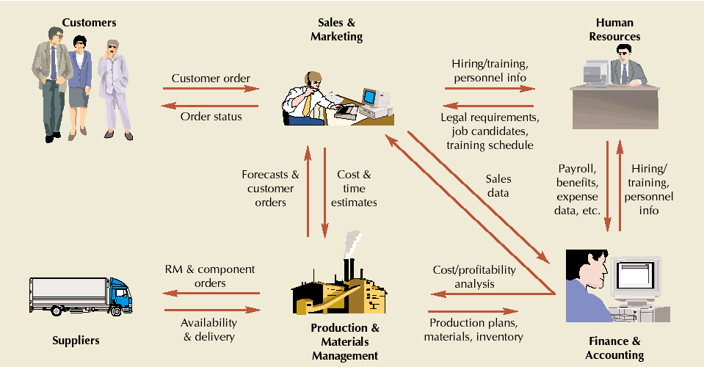
Organizational Data Flows

Slide 46
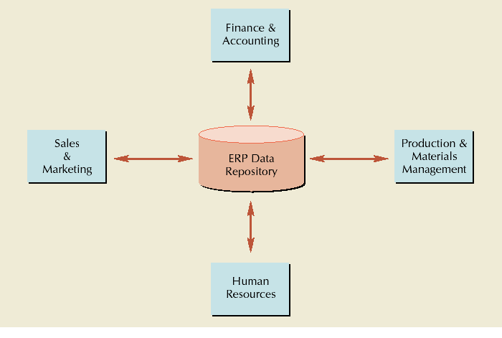
ERP’s Central Database

Slide 47
ERP Implementation
Analyze business processes (external consultants $$$$$)
Choose modules to implement
Which processes have the biggest impact on customer relations?
Which process would benefit the most from integration?
Which processes should be standardized?

Slide 48
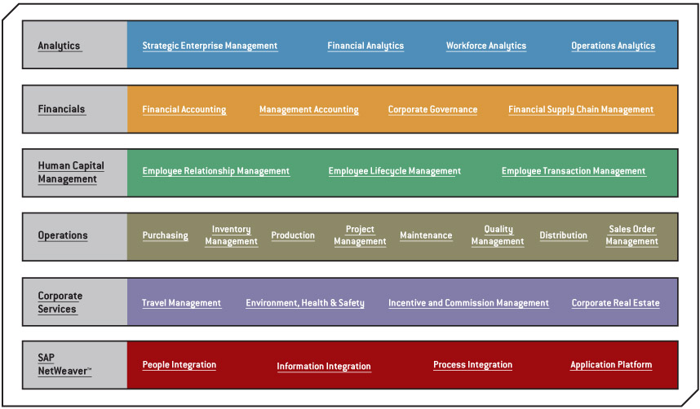
Choose modules to implement: SAPs ERP Business Map

Slide 49
Customer Relationship Management (CRM)
Software that
Plans and executes business processes
Involves customer interaction
Changes focus from managing products to managing customers
Analyzes point-of-sale data for patterns used to predict future behavior

Slide 50
Supply Chain Management
Software that plans and executes business processes related to supply chains
Includes
Supply chain planning
Supply chain execution
Supplier relationship management
Distinctions between ERP and SCM are becoming increasingly blurred

Slide 51
In the Lecture we covered:
Sales and Operational Planning
The Sales and Operations Planning Process
Strategies for Adjusting Capacity
Strategies for Managing Demand
Quantitative Techniques for Aggregate Planning
Hierarchical Nature of Planning
Aggregate Planning for Services
Resource Planning
Material Requirements Planning (MRP)
Capacity Requirements Planning (CRP)
Enterprise Resource Planning (ERP)
Customer Relationship Management (CRM)
Supply Chain Management (SCM)

Slide 52
Next Week: Last Lecture
Lean Systems

